Slide 1

Huawei HCCDA-AI certification
Trainer: Fawad Bahadur Marwat
1

Slide 2
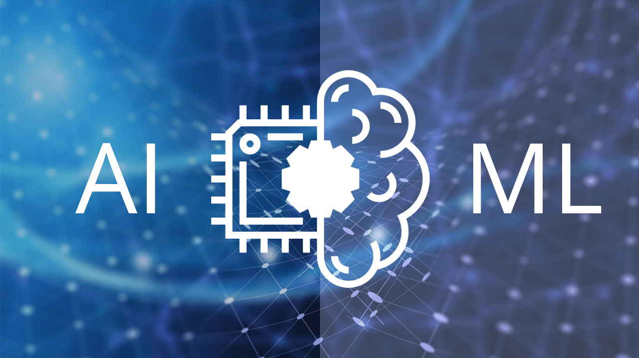
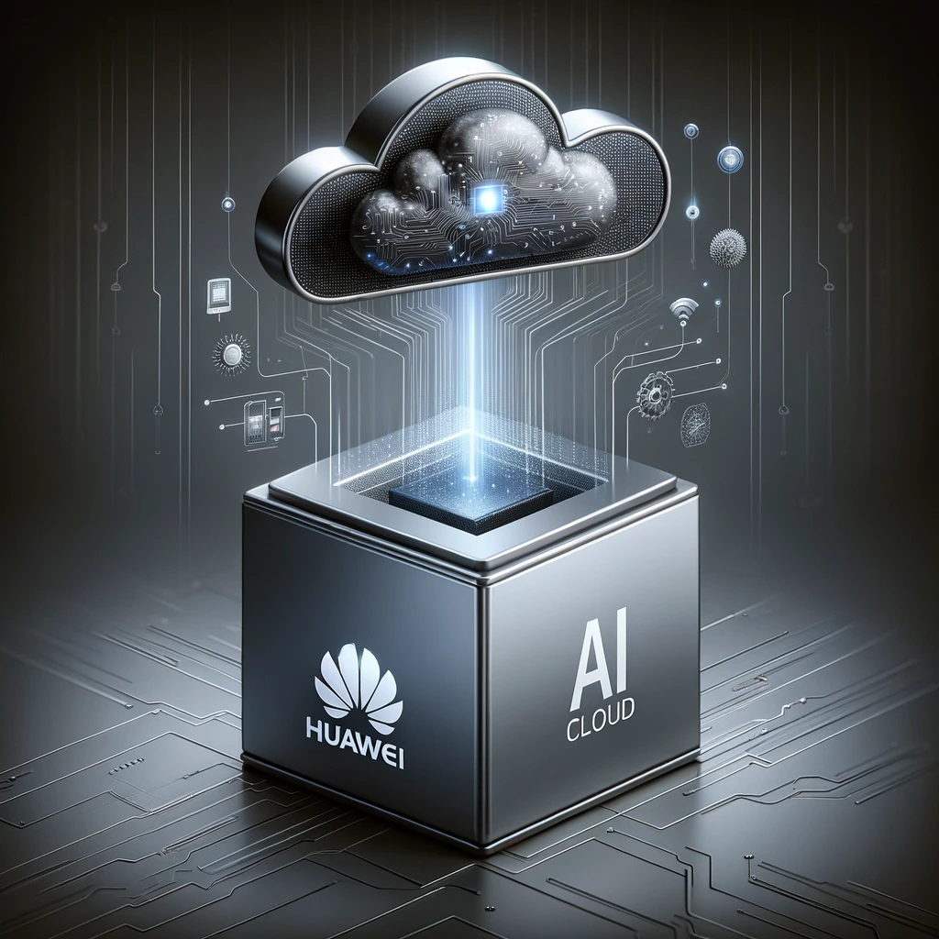

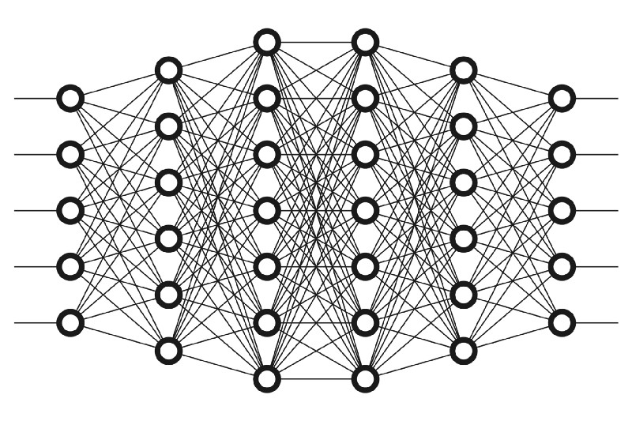
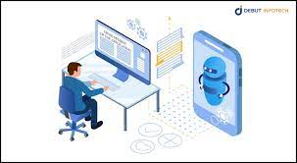
Training Objective & Outcomes
AI/ML Fundamentals
Huawei Cloud AI services
ModelArts
Real-world AI application development
Deep learning frameworks
Trainer: Fawad Bahadur Marwat

Slide 3
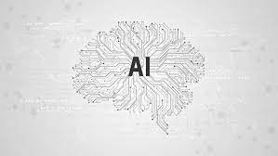
Artificial Intelligence
Definition
Computer systems capable of performing complex tasks that historically only a human could do,
Such as
Reasoning,
Making decisions, or
Solving problems
Trainer: Fawad Bahadur Marwat

Slide 4
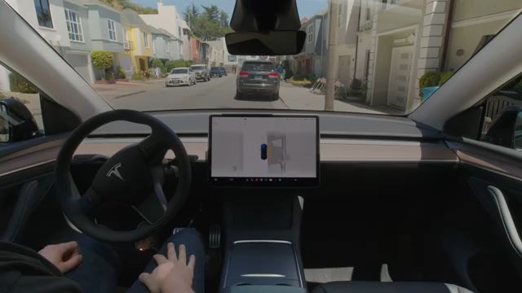
Artificial Intelligence
Definition
Computer systems capable of performing complex tasks that historically only a human could do,
Such as
Reasoning,
Making decisions, or
Solving problems
Autonomous Vehicle
Trainer: Fawad Bahadur Marwat

Slide 5

Artificial Intelligence
Definition
Computer systems capable of performing complex tasks that historically only a human could do,
Such as
Reasoning,
Making decisions, or
Solving problems
Image Recognition
Trainer: Fawad Bahadur Marwat

Slide 6
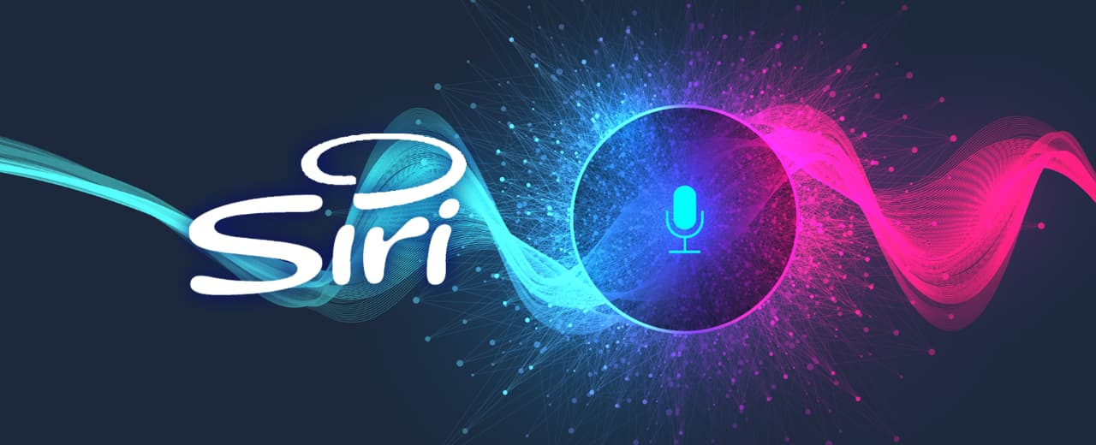
Weak VS Strong AI
Weak
AI designed for a specific task and operates within a limited context.
Characteristics
Excels at one particular function
Does not possess consciousness or self-awareness.
Cannot generalize beyond its trained domain.
Trainer: Fawad Bahadur Marwat

Slide 7

Weak VS Strong AI
Weak
AI designed for a specific task and operates within a limited context.
Characteristics
Excels at one particular function
Does not possess consciousness or self-awareness.
Cannot generalize beyond its trained domain.
Trainer: Fawad Bahadur Marwat

Slide 8
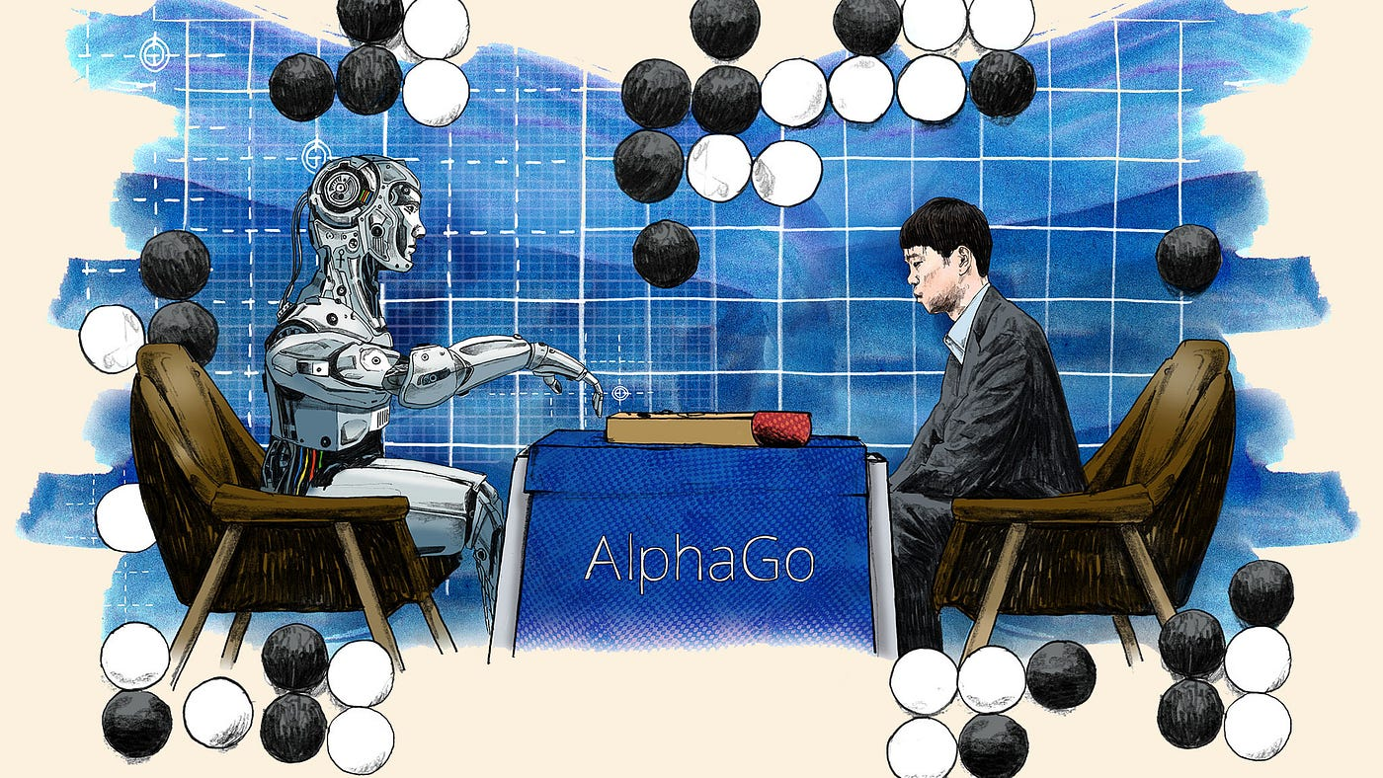
Weak VS Strong AI
Weak
AI designed for a specific task and operates within a limited context.
Characteristics
Excels at one particular function
Does not possess consciousness or self-awareness.
Cannot generalize beyond its trained domain.
Trainer: Fawad Bahadur Marwat

Slide 9
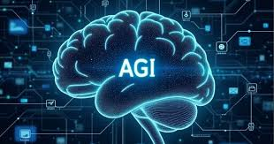
Weak VS Strong AI
Weak
Strong
AI designed for a specific task and operates within a limited context.
Characteristics
Excels at one particular function
Does not possess consciousness or self-awareness.
Cannot generalize beyond its trained domain.
AI with human-like cognitive abilities, capable of reasoning, learning, and applying knowledge across various domains.
Characteristics
Can perform any intellectual task a human can.
Possesses self-awareness, consciousness, and understanding.
Adapts to new situations without explicit programming.
Current Status: Does not yet exist; remains theoretical.
Trainer: Fawad Bahadur Marwat

Slide 10
Historical evolution of artificial intelligence
1
2
3
Early Foundations
(1940–1950)
Golden Age & Early Optimism (1950–1970)
First AI Winter
(1970–1980)
4
5
Rise of Machine Learning
1980–1990
Modern AI Boom
2000–Present
Trainer: Fawad Bahadur Marwat

Slide 11
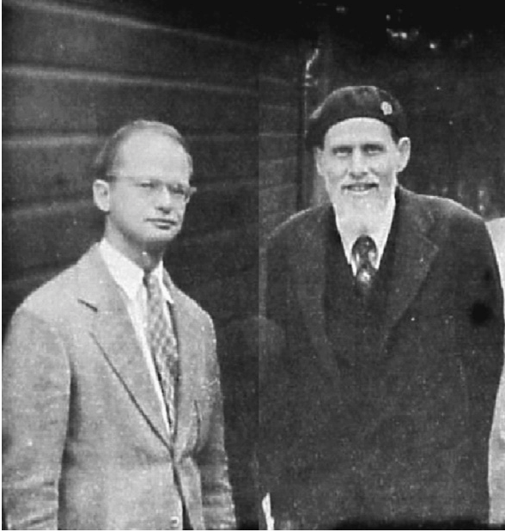
Historical evolution of artificial intelligence
Early Foundations (1940s–1950s)
1943
McCulloch & Pitts
Propose a computational model of neural networks, laying groundwork for AI.
Trainer: Fawad Bahadur Marwat

Slide 12
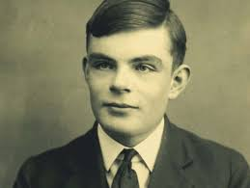
Historical evolution of artificial intelligence
Early Foundations (1940s–1950s)
1943
McCulloch & Pitts
1950
Alan Turing
Publishes "computing machinery and intelligence", introducing the turing test for machine intelligence.
Trainer: Fawad Bahadur Marwat

Slide 13
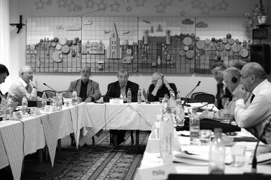
Historical evolution of artificial intelligence
Early Foundations (1940s–1950s)
1943
McCulloch & Pitts
1950
Alan Turing
1956
Dartmouth conference
Coins the term "Artificial Intelligence" and establishes ai as a field.
Trainer: Fawad Bahadur Marwat

Slide 14
Historical evolution of artificial intelligence
Early Foundations (1940s–1950s)
1943
McCulloch & Pitts
1950
Alan Turing
1956
Dartmouth Conference
Trainer: Fawad Bahadur Marwat

Slide 15
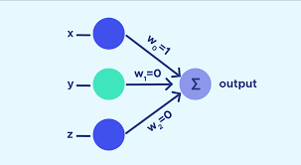
Historical evolution of artificial intelligence
Golden Age & Early Optimism (1950s–1970s)
1956–1969
Logic-Based AI: Programs like Logic Theorist (Newell & Simon) prove mathematical theorems.
ELIZA (1966): Early chatbot simulating a psychotherapist (Joseph Weizenbaum).
Perceptrons (1957): Frank Rosenblatt’s early neural network model.
Trainer: Fawad Bahadur Marwat

Slide 16
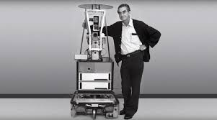
Historical evolution of artificial intelligence
Golden Age & Early Optimism (1950s–1970s)
1969
Shakey the Robot
First general-purpose mobile robot using logic and planning.
Trainer: Fawad Bahadur Marwat

Slide 17
Historical evolution of artificial intelligence
First AI Winter
(1970s–1980s)
1970
Marvin Minsky
Expert Systems (e.g., MYCIN for medical diagnosis) gain traction using rule-based logic.
Japan’s Fifth Generation Project (1982) reignites interest but eventually stalls.
.
Trainer: Fawad Bahadur Marwat

Slide 18
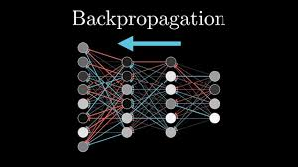
Historical evolution of artificial intelligence
Rise of Machine Learning
1980s–1990s
1986s
Backpropagation
(Rumelhart, Hinton, Williams) revives neural networks.
Trainer: Fawad Bahadur Marwat

Slide 19
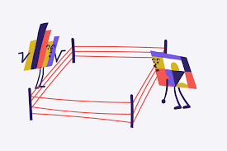
Historical evolution of artificial intelligence
Rise of Machine Learning
1980s–1990s
1986s
Backpropagation
1990s
Statistical ML
(e.g., SVMs, Bayesian networks) replaces symbolic AI in many domains..
Trainer: Fawad Bahadur Marwat

Slide 20
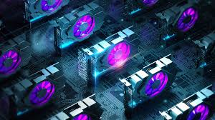
Historical evolution of artificial intelligence
Modern AI Boom
2000s–Present
2000s
Big Data & GPUs
Cheap storage and parallel computing enable training complex models.
Trainer: Fawad Bahadur Marwat

Slide 21
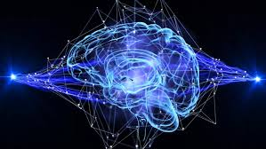
Historical evolution of artificial intelligence
Modern AI Boom
2000s–Present
2010s
Deep Learning Revolution
2012: AlexNet (Hinton et al.) dominates ImageNet, popularizing CNNs.
2014: GANs (Generative Adversarial Networks) emerge.
2017: Transformer architecture (Vaswani et al.) revolutionizes NLP (later used in GPT, BERT).
2000s
Big Data & GPUs
Trainer: Fawad Bahadur Marwat

Slide 22
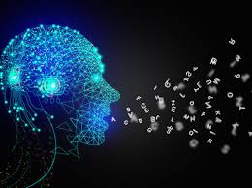
Historical evolution of artificial intelligence
Modern AI Boom
2000s–Present
2020s
Generative AI
ChatGPT (2022), DALL-E, and multimodal models blur lines between human/machine creativity.
2000s
Big Data & GPUs
2010s
Deep Learning Revolution
Trainer: Fawad Bahadur Marwat

Slide 23
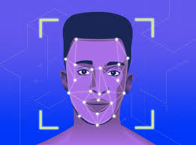
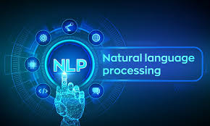
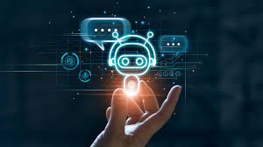
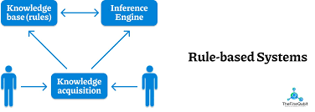
Symbolic vs Machine Learning AI
Symbolic AI
Machine Learning AI
Uses predefined rules and knowledge representation
Relies on human expertise and logic
Suitable for well-defined problems
Examples
Learns from data and identifies patterns
Improves performance over time
Suitable for complex, data-driven problems
Examples
Image Recognition
Natural Language Processing
Logic Based
Rule-based systems
Trainer: Fawad Bahadur Marwat

Slide 24
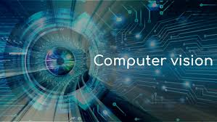
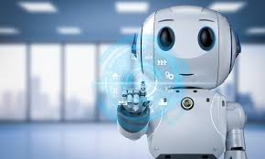
Key Domains in AI
Natural Language Processing
Computer Vision
Robotics
NLP deals with the interaction b/w computers and human (natural) language.
Natural Language Understanding
Natural Language Generation
Speech Recognition
Machine Translation etc.
Computer Vision enables computers to see, interpret and understand the visual world.
Image classification
Object Detection
Object Tracking
Facial Recognition etc.
Robotics is a multidisciplinary field that integrates AI with Physical machines (robots) to enable them to perform tasks, often autonomously in the real world.
Perception
Motion Planning
Manipulation
Human-robot interaction
Trainer: Fawad Bahadur Marwat

Slide 25

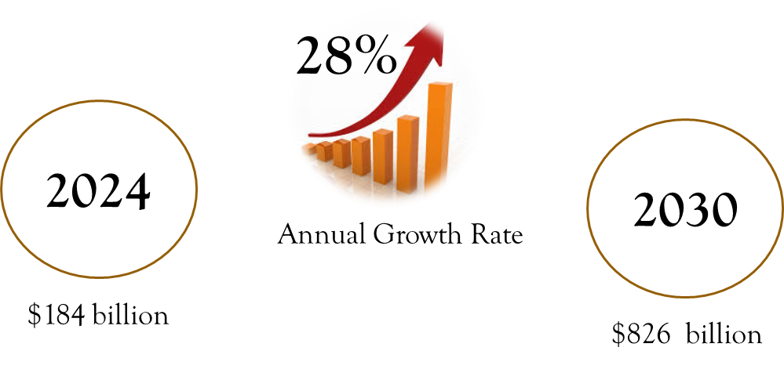
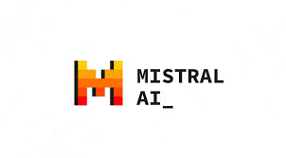






Global AI Industry Landscape
Trainer: Fawad Bahadur Marwat

Slide 26
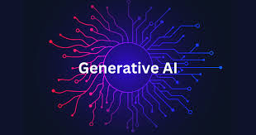
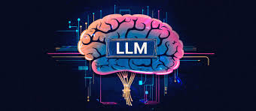
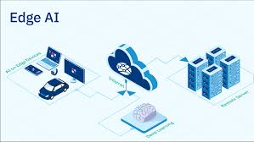
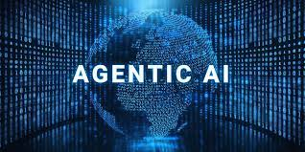
Artificial Intelligence Trends
Generative AI (GenAI)
Large Language Models (LLMs)
Edge AI
Agentic AI
Trainer: Fawad Bahadur Marwat

Slide 27

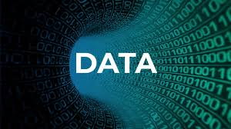

Challenges in AI Adoption
Data
Garbage in, Garbage out
Siloed Data
Data Scarcity
Privacy Concerns
Cost and ROI Justification
Significant Upfront Investment
Uncertain ROI
Operational Costs
Talent Acquisition
Regulation and Compliance
Evolving Landscape
Ethical Concerns
"Black Box" Problem
Trainer: Fawad Bahadur Marwat

Slide 28
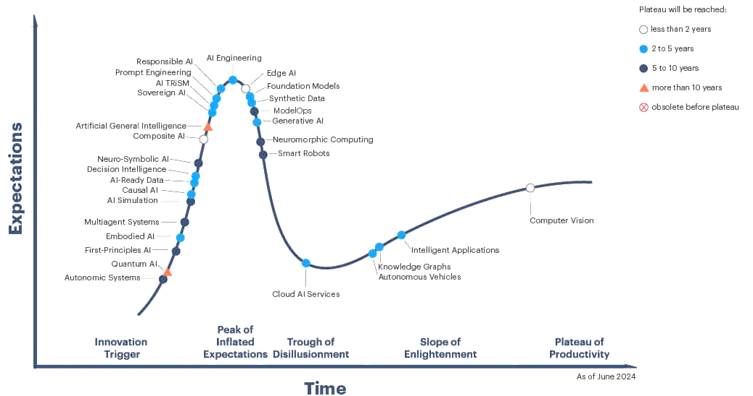
Gartner Hype Cycle for Artificial Intelligence
Trainer: Fawad Bahadur Marwat

